Slide 1

2026 Employee Benefits
Open Enrollment
Open Enrollment Dates: Tuesday, October 21st – Monday, November 3rd
Notes:
Hello and welcome to this year’s benefits open enrollment presentation. During this presentation, you will be provided with an overview of the plans offered to eligible employees and family members, along with resources available to assist you with any benefit-related issues now and throughout the year.

Slide 2
Key Information
The 2026 Benefit Open Enrollment Period is Tuesday, October 21st – Monday, November 3rd
All benefit elections and changes will take effect 01/01/2026
All payroll deductions will begin January 9th
The deadline to enroll is November 3rd
Notes:
The benefits open enrollment period is your opportunity to make changes to your benefit elections and review which dependents you will cover. All benefit elections and changes will take effect on January 1st, and payroll deductions will begin January 9th . Be mindful of the enrollment deadline of November 3rd to ensure your benefits are updated without issue.

Slide 3
Open Enrollment
Opportunity to make changes to your benefit elections and to review which dependents you will cover
Elections made during this period will remain in effect for a 12-month period, unless you experience an IRS-approved “qualifying event”
Approved qualifying events include:
  Marriage or Divorce
  Death
  Birth or adoption of a dependent
  Change in employment status
  Change in dependent’s eligibility status
  Loss of or significant change to your current coverage
  Judgment, decree or court order
You have 30 days from the date of the event (varies by state) to notify Human Resources
Notes:
Open enrollment is the one time per year you can make changes to your benefit plans without a qualifying event. A qualifying event, such as marriage, divorce, or the birth of a child, allows you to make changes mid-plan year. Absent one of these events, the only time you can make changes to your benefit selection is during open enrollment. All elections are effective at the start of your plan year!

Slide 4
2026 Changes
What’s Changed​
New Vision Carrier EyeMed​
New Life and Disability Carrier Mutual of Omaha
​Special Open Enrollment this year for Voluntary Life
What’s Hasn’t Changed​
No change to the benefits of existing two medical plans and your pharmacy benefits​
Your Dental benefits​

Slide 5


Medical/Rx
Notes:
Now, we will review the medical plan options for benefit year.

Slide 6
Important
When you use your medical plan​
You will hear the term CEBCO​
CEBCO is an organization of Ohio Counties​
CEBCO offers counties a medical program with Anthem/CarelonRx​
​
Always tell your medial providers that your medical coverage is with Anthem!​
Always tell your pharmacy provider your coverage is with CarelonRx!​
​
Do not use the name CEBCO – Providers will not be familiar with that name​

Slide 7
Medical/Rx - Definitions
Copay | Flat dollar amount member is responsible for at the time of service. The plan usually pays 100% of the remaining balance.
Deductible | Amount member is responsible for before the plan pays for certain services.
Coinsurance | Percentage of payment shared between the member and the plan for certain services after the deductible has been met.
Out-of-Pocket Maximum | Member total payments for deductible, coinsurance and copays to stated maximum per plan year. Once reached, the plan will pay 100% for eligible expenses for the rest of the plan year.
High-Deductible Health Plan (HDHP) | Qualified plan as defined by the IRS. No first dollar benefits, all services are subject to the deductible before the plan will pay. Exception is Routine Preventive Care as defined by the IRS.
HSA – Health Savings Account | Tax Free account that is established by the employee that is covered by a High-Deductible Health Plan (HDHP).
Network Provider | Medical and pharmacy providers that have contracted with the plan to provide lower out-of-pocket costs for members.
Notes:
Health insurance can be complicated, so here are some key terms to help you navigate your plans:
- Copay: Flat dollar amount member is responsible for at the time of service.
- Deductible: Amount member is responsible for before the plan pays for certain services.
- Coinsurance: Percentage of payment shared between the member and the plan for certain services after the deductible has been met.
- Out-of-Pocket Maximum: Total payments for deductible, coinsurance, and copays to a stated maximum per plan year. Once reached, the plan will pay 100% for eligible expenses for the rest of the plan year.
- High Deductible Health Plan (HDHP): Qualified plan as defined by the IRS.
- HSA (Health Savings Account): Tax-free account for members covered by a High Deductible Health Plan (HDHP).
- Network Provider: Providers contracted with the plan to provide lower out-of-pocket costs for members.

Slide 8
Medical/Rx – Plan Highlights
PREVENTIVE CARE – Covered at 100% on all medical plan options.
Know what services are covered at 100% by Anthem Insurance Companies Inc prior to your preventive care visit
Routine preventive for Children*
Appropriate screenings based on gender and age
  Newborn visits
  Tuberculosis testing
  Anemia testing
  Lead exposure
  Development and behavior
  Lipid profile
  Depression
  Obesity and counseling
  Nutrition counseling
*Birth to age 18
Routine preventive for Adults
Appropriate screenings based on gender and age
  Lipid profile
  Diabetes
  Eye exam
  Pelvic exam and pap testing
  Breast exam and mammogram
  Bone density testing
  Colonoscopy
  Aortic aneurysm
Annual preventative wellness exam visits can be done any time of year. Wellness exams do not have to be one year apart from each other, but they do have to be in a separate calendar year.
Notes:
Preventive care is covered at 100% on all medical plan options. This includes routine preventive care for adults and children, based on gender and age. Some services might include lipid profile, diabetes, pelvic exam and pap testing, breast exam and mammogram, PSA testing, bone density testing, colonoscopy, and aortic aneurysm.

Slide 9
Services to keep in mind…
Lab work processed through a stand-alone LabCorp/Quest location or a facility that sends labs to LabCorp to be processed is covered at 100% as long as it is a covered lab service​
12 Chiropractic visits are covered per plan year​
After 12 visits check with your provider on contracted rates​
30 Physical Therapy visits per plan year​
In-office visits cost a Specialty Copay​
Outpatient visits are subjected to deductible and coinsurance​
24/7 NurseLine, you can connect with a registered nurse who will answer your health questions anytime, day or night. They can help you decide where to go for care and find doctors and other care providers in your area.
24/7 digital support, Building Healthy Families is here to help your family with everything from preconception and pregnancy to childbirth and early childhood. The program features an extensive content library to support diverse families, including single parents, same-sex, or multicultural couples. Log in to anthem.com or the Sydney app to access the library and other tools, such as fertility, diaper change, and feeding trackers; due date calculators; and blood pressure monitoring

Slide 10
Medical – Plan Highlights
Anthem | Medical Premium Copay | Medical Basic Copay | Medical HDHP/HSA
Annual Deductible | $2,000 per individual $4,000 per family | $5,000 per individual $10,000 per family | $3,400 per individual $6,800 per family
Annual Out-of-Pocket Maximum | $5,000 per individual $10,000 per family | $6,000 per individual $12,000 per family | $4,000 per individual $8,000 per family
Plan Coinsurance (after deductible) | 80% in most cases | 90% in most cases | 90% in most cases
Office Visit | $10 Copay | $35 copay | 90%, after deductible
Lab & X-ray | 80%, after deductible | 90%, after deductible | 90%, after deductible
Complex Radiology | 80%, after deductible | 90%, after deductible | 90%, after deductible
Inpatient Hospital | 80%, after deductible | 90%, after deductible | 90%, after deductible
Emergency Room | $300 copay | $350 copay | 90%, after deductible
Out-of-Network Benefits are double the In-Network. See the summary of benefits for details.
Employee Contributions (per pay / 24 pays per year) | Medical Premium Copay | Medical Basic Copay | Medical HDHP/HSA
Single | $45.35 | $10.30 | $30.90
EE + Spouse | $139.67 | $118.72 | $101.93
EE + Child(ren) | $112.97 | $96.03 | $81.52
Family | $202.89 | $172.47 | $145.83
Employer Health Savings Account Contribution (when electing HDHP): Single Coverage: $25 / All Other Coverage: $50 per pay
Medical Plan Spousal Surcharge: $50 per pay extra for spousal coverage if the spouse has medical available through their own employer
Tobacco User Rates: $25 upcharge per pay (in addition to selected plan rate)
Notes:
You will have three plans to choose from. The Anthem Premium Copay PPO Plan, Basic Copay PPO Plan, and The High Deductible/HSA Plan
First let’s go over the Premium PPO Plan: Your annual deductible is $2,000 individual and $4,000 Family. Your annual out of pocket maximum is $5,000 individual and $10,000 family. Once you meet your deductible, you will be responsible for 20% of the cost for all services, except Office Visits have a $10 copay and Emergency Room visits have a $300 copay. Preventive Services are covered in full.
Next let’s go over the Basic PPO Plan: Your annual deductible is $5,000 individual and $10,000 Family. Your annual out of pocket maximum is $6,000 individual and $12,000 family. Once you meet your deductible, you will be responsible for 10% of the cost for all services, except Office Visits have a $35 copay and Emergency Room visits have a $350 copay. Preventive Services are covered in full.
You also have the High Deductible/HSA Plan: Your annual deductible is $3,400 Individual and $6,800 per family. Your annual out of pocket maximum is $4,000 per individual and $8,000 per family. Once you meet your deductible, you will be responsible for 10% of the cost for all services. Preventive Services are covered in full, with no deductible. You will also receive $25 per pay for single or $50 per pay for all other tiers into your Health Savings Account from Clermont County to help offset your medical expenses.
Please note the HDHP individual deductible was updated to $3,400 per the IRS guidelines for 2026.

Slide 11
Prescription Drug– Plan Highlights
CarelonRx | Anthem BCBS Medical Premium Copay | Anthem BCBS Medical Basic Copay | Anthem BCBS HDHP/HSA
Rx Deductible | N/A | N/A | Prescription drug cost are subject to the annual medical deductible
Retail Prescription Drugs 30-day Fill
Generic | $15 copay | $15 copay | 90%, after deductible
Preferred Brand Name | $50 copay | $50 copay | 90%, after deductible
Non-Preferred Brand Name | $70 copay | $100 copay | 90%, after deductible
Preferred Specialty | $70 copay | $100 copay | 90%, after deductible
Mail-Order Prescriptions 90-Day Fill
Mandatory for Maintenance Rx? | N/A | N/A | N/A
Generic | $30 copay | $30 copay | 90%, after deductible
Preferred Brand Name | $100 copay | $100 copay | 90%, after deductible
Non-Preferred Brand Name | $140 copay | $200 copay | 90%, after deductible
Notes:
Here are some further examples of what your cost sharing would be for each plan option, focused specifically on prescription drug benefits.
Let’s take a moment to review your Prescription drug Cost:
First let’s look at the Premium Copay PPO Plan:
There is no deductible for this plan
Retail:
Generic: $15 copay
Preferred Brand Name: $50 Copay
Non- Preferred Brand Name $70 Copay
Preferred Specialty: $70 copay
Mail-Order:
Generic: $30 copay
Preferred Brand Name: $100 Copay
Non- Preferred Brand Name $140 Copay
Next let’s look at the Basic Copay PPO Plan:
There is no deductible for this plan
Retail:
Generic: $15 copay
Preferred Brand Name: $50 Copay
Non- Preferred Brand Name $100 Copay
Preferred Specialty: $100 copay
Mail-Order:
Generic: $30 copay
Preferred Brand Name: $100 Copay
Non- Preferred Brand Name $200 Copay
Now let’s review the High Deductible/HSA Plan
For both Retail and Mail order you are
Subject to annual medical deductible.
Once you meet the deductible you are responsible for 10% up to the Out of pocket maximum.

Slide 12
CarelonRx Maintenance 90 Program
Maintenance drugs are medications taken everyday for conditions like high blood pressure, asthma, heartburn, thyroid disease or diabetes. ​
When using this benefit, you must fill prescriptions for maintenance drugs at an Rx Maintenance 90 pharmacy or through home delivery. ​
Members impacted will be notified by Anthem by mail and will have (2) 30-day courtesy fills before switching to the 90-day fill.​
Benefits of this program are:​
  Getting a 90-day fill but paying for only 60-day​
  Members receiving 90-day fills at a time, there is a higher rate of coherence with maintenance medications​

Slide 13
CarelonRx Cost Relief Drug Program
CarelonRx's Cost Relief program helps members get specialty drugs at no out-of-pocket cost. The program works by: ​
Accessing manufacturer copay assistance. The program works with drug manufacturers to get copay card assistance and maximize available dollars. ​
Managing enrollment and renewals: ​
  The program offers personalized enrollment support and manages renewals. ​
  Specialists provide outreach to manage and coordinate complex and expensive specialty medications. ​
Members can enroll at any time, but members must sign up. This program benefit is not automatic. ​
Only eligible prescriptions filled after enrollment into the program will have a $0 out-of-pocket cost. ​
If a member renews in a plan that includes Cost Relief, they won't need to re-enroll each year. ​

Slide 14
How to Choose My Plan
Review your prior year’s medical expenses
Review your total claim costs
Ask yourself these questions:
  Do I anticipate any surgeries or hospitalizations for me or my family in the upcoming year?
  Do I prefer a higher deductible with a lower payroll deduction?
  Am I prepared to pay the high deductible in case of an unexpected medical event?
Notes:
So you may be asking, what plan should I choose?
Review your prior year’s medical expenses
Review your total claim costs
Ask yourself these questions:
Do I anticipate any surgeries or hospitalizations for me or my family in the upcoming year?
Do I prefer a higher deductible with a lower payroll deduction?
Am I prepared to pay the high deductible in case of an unexpected medical event?

Slide 15
Anthem Wellness Program
Anthem covered employees and their covered spouses can each earn up to $200 | Preventive Care | Condition Management | Digital & Wellness Activities
Complete any of the activities sponsored by your employer and you’ll earn rewards to put toward electronic gift cards for select retailers. | Wellness Exam/Well Woman ($50) Diabetic A1C* Lab Test ($25) Cholesterol* Test ($25) Prostate Exam ($25) Colorectal Cancer Screening ($25) Mammogram ($25) | Condition Care ($25) Asthma Diabetes Heart Disease or Heart Failure Chronic Obstructive Pulmonary Disease (COPD) | Log in to Sydney ($25) Log Active Minutes (Max $50) My Health Check-In ($25) Team Challenge 1 ($25) Team Challenge 2 ($25) Team Challenge 3 ($25) Team Challenge 4 ($25)
Program resets on July 1, 2026
Redeem your rewards on the Sydney Health mobile app or anthem.com, under “MyHealth Dashboard” and then select “My Rewards”.
Notes:
Why is Wellness important?
Visiting your primary care physician (PCP) for an annual physical can identify asymptomatic issues, connect you with resources for things like stopping smoking or losing weight and can help you better manage your health.
Reducing the number of unknown health risks reduces the likelihood of a catastrophic health event.
We all need to work together to fight rising health care costs.

Slide 16
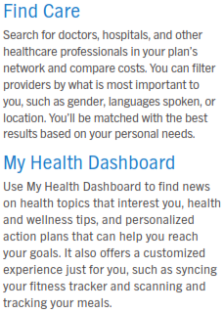
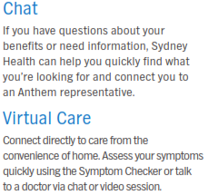
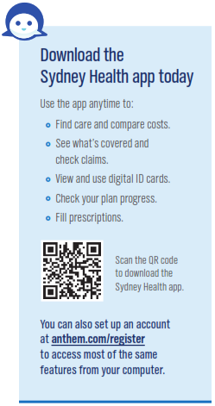
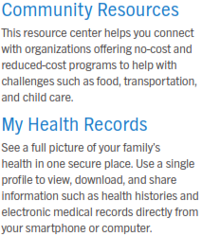
Sydney Health Mobile App
9126768 5/19 19-12448

Slide 17


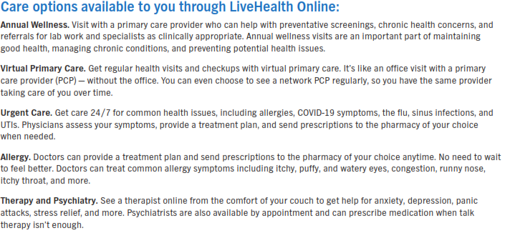

See a doctor wherever, whenever.
9126768 5/19 19-12448
Proprietary information of UnitedHealth Group. Do not distribute or reproduce without express permission of UnitedHealth Group.
Notes:
Virtual Visits. Get access to care online, at any time.
When you need care - anytime, day or night - Virtual Visits can be a convenient option. From treating flu and fevers to caring for migraines and allergies, you can talk to a doctor by video or phone 24/7.
LiveHealth Online Psychiatric lets you visit a psychiatrist or therapist through video chat on your computer or smartphone. Members can see a therapist for 45-minute counseling sessions. Members can also see a Psychiatrist for assistance with managing psychiatric medications but cannot prescribe medication.
Both LiveHealth Online Medical and Psychiatric provide unlimited visits and are provided at a $0 cost for Co-pay plans & $55 per visit for High-Deductible Plan.
Available through the Sydney App, Anthem.com, LiveHealthOnline.com or LiveHealth App

Slide 18

Lark Diabetes Prevention Program
The Lark Diabetes Prevention Program is an all-digital app that can help you lose weight and lower your risk of developing Type 2 Diabetes.
The program is customized based on your lifestyle and you will receive 24/7 coaching to provide you with tools for healthier habits to reduce your risk. Lark is offered to qualifying CEBCO members at no charge!
After enrolling, members will receive a free smart scale and a free Fitbit2 that links with the Lark app to aid in their success.
Go to lark.com/anthem to take the one-minute survey to see if you qualify.
Available dependents 18+ years of age.
Additional Anthem Benefits must be enrolled in medical to be eligible
Notes:
Anthem and Lark have come together to offer this 12-month weight loss program that can help you lose weight and reduce your risk for diabetes.
Get personalized 24/7 coaching to help you:
Lose weight​
Manage stress​
Eat healthier​
Sleep better​
Increase activity

Slide 19
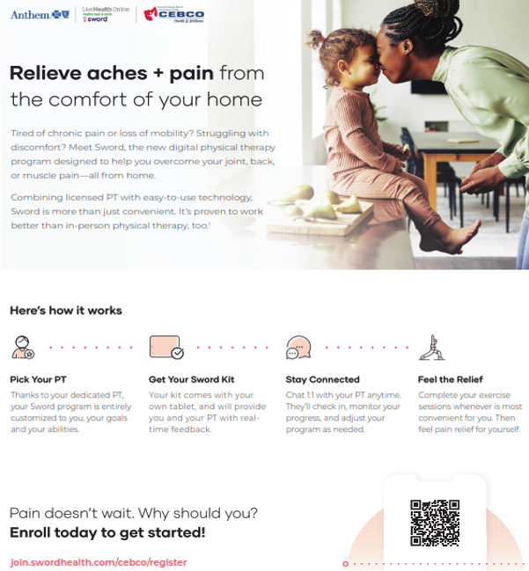
SWORD Program
Additional Anthem Benefits must be enrolled in medical to be eligible
Notes:
Solving for pain holistically​
MSK is a common problem – 50% of people suffer from MSK pain​
This solution gives access to care that’s convenient​
No cost, no referral, and does not count towards PT visits
Enroll in the program​
Provide clinical information so the PT can tailor the program to you​
Select PT, schedule first visit, and receive your Kit (tablet and motion sensors)​
Complete digital sessions
How long does the program last? There is no fixed time, but typically 8-12 weeks.​
How long do sessions last? Usually 20-30 minutes.​
Hoe often do I perform the sessions? We recommend 3 to 5 days per week.​
Can I continue after the initial period? Yes, and you can keep your digital therapy kit.​
How do I contact my PT? Through the chat feature on the app, video calls, or by phone.

Slide 20

Bloom
Additional Anthem Benefits must be enrolled in medical to be eligible
Notes:
Relieve pelvic health symptoms from home ​
1 in 3 women suffer from pelvic health disorders including bladder issues, bowel dysfunction, and pelvic pain.​
No cost, no referral needed​
Take the onboarding survey​
Select your pelvic health specialist​
Get your Bloom kit​

Slide 21



SmartShopper
Additional Anthem Benefits must be enrolled in medical to be eligible
9126768 5/19 19-12448
Notes:
Earn a reward check every time you and your family choose an eligible lower-cost, high-value doctor or facility for a variety of health services. Simply call a SmartShopper representative or register on the website to search for competitive costs and high quality care for your next procedure or service and get paid doing it!​

Slide 22

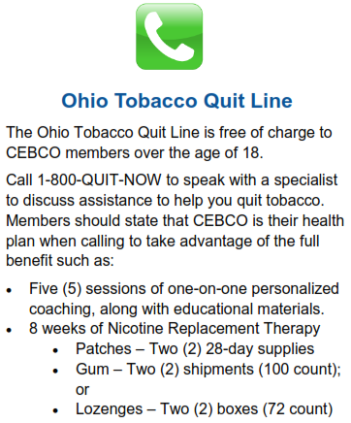
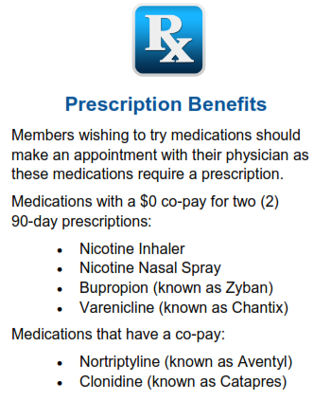

Tobacco Cessation
10055803 7/20 19-14113
Notes:
The Quit For Life program is designed to help you to overcome tobacco dependency. Featuring the latest in digital and online tools such as a website, app, Quit Coach®, text messaging and more, the Quit For Life program is there for your support.
Receive access to a website to access the quit guide, which features tips to help you overcome urges, manage withdrawal symptoms and change your daily habits to avoid tobacco triggers. The site also features other tools such as a cost savings calculator, Live Tobacco-Free course, quizzes and more.

Slide 23

Spending Accounts
Notes:
Now we will cover tax benefit accounts available to you through your employer.

Slide 24
Health Savings Account (HSA)
What is a Health Savings Account (HSA)?
A health savings account (HSA) is an account that you can use to pay medical expenses.
  This account helps offset your medical and prescription costs by giving you tax advantages, allowing your income to stretch farther by using the dollars that would have otherwise been paid in taxes.
BUT there are still a few rules:
You must be covered under a high-deductible healthcare plan (HDHP) on the first day of the month.
You must not be covered by health coverage that is not an HDHP or a spouse’s full purpose FSA
You must not be enrolled in Medicare.
You must not be claimed as a dependent on someone else’s tax return.
  You have to spend the dollars on qualified medical expenses and keep itemized receipts.
Notes:
What is a Health Savings Account (HSA)?
A health savings account (HSA) is an account that you can use to pay medical expenses.
This account helps offset your medical and prescription costs by giving you tax advantages, allowing your income to stretch farther by using the dollars that would have otherwise been paid in taxes.
BUT there are still a few rules:
You must be covered under an HDHP on the first day of the month.
You must not be covered by another health coverage (a non-qualified medical plan that is not an HSA or a spouse’s full purpose FSA)
You must not be enrolled in Medicare
You must not be claimed as a dependent on someone else’s tax return.
You have to spend the dollars on qualified medical expenses and keep itemized receipts.

Slide 25

HSA: How Much Can I Contribute?
2026 Individual Enrollment: $4,400
2026 Family Enrollment: $8,750
For 2026 Clermont County contributes $25 per pay to your single HSA or $50 per pay to any other tier.
Subtract this amount from your maximum allowed.
Please remember:
  These maximums should include any employer contributions.
  Those 55 years and older and not enrolled in Medicare can contribute an additional $1,000 “catch-up” each year.
  If you have not had an HSA previously you will need to open up an HSA Account at a bank or credit union of your choice.
Notes:
So you may be asking, How much can I contribute?
2026 Individual Enrollment: $4,400
2026 Family Enrollment: $8,750
For 2026: Clermont County contributes $25 per pay to your single HSA or $50 per pay to any other tier.
Subtract this amount from your maximum allowed.
Please remember:
These maximums should include any Employer + Employee contributions.
Those 55 years and older and not enrolled in Medicare can contribute an additional $1,000 “catch-up” each year.
If you have not had an HSA previously you will need to open up an HSA Account at a bank or Credit Union of your choice.
Keep in mind, banks charge a fee and credit unions do not. Credit Unions usually have better investment opportunities as well.

Slide 26

Flexible Spending Accounts
Healthcare FSA annual maximum - $3,400
  Allows IRS-approved medical, Rx, dental or vision expenses not covered by the insurance plan with pre-tax dollars.
  You can now carryover up to $500 to the following calendar year.
  Full annual election amount available immediately.
  Some examples include:
    Medical and Pharmacy copays and out-of-pocket expenses
    Hearing services, including hearing aids and batteries
    Vision services, including contact lenses and solution, eye exams and eyeglasses
    Dental services and orthodontia
    Over-the-Counter medications when prescribed by a Physician
      Require substantiation for any expenses that are not a copay on the medical or pharmacy plan.
Limited Healthcare FSA - Allows IRS-approved dental or vision expenses not covered by the insurance plan with pre-tax dollars.
  If you are contributing to an HSA account, you can only enroll in the Limited FSA.
Notes:
The Healthcare FSA annual maximum is $3,400. The Healthcare FSA allows IRS-approved medical, Rx, dental or vision expenses not covered by the insurance plan with pre-tax dollars.
You can now carryover up to $500 into 2026
The Full annual election amount is available immediately.
Some examples of eligible medical expenses include:
Medical and Pharmacy copays and out-of-pocket expenses
Hearing services, including hearing aids and batteries
Vision services, including contact lenses and solution, eye exams and eyeglasses
Dental services and orthodontia
Over-the-Counter medications when prescribed by a Physician will Require substantiation for any expenses that are not a copay on the medical or pharmacy plan.
Another option is the Limited Healthcare FSA which allows IRS-approved dental or vision expenses not covered by the insurance plan with pre-tax dollars. It’s Important to know that If you are contributing to an HSA account, you can only enroll in the Limited FSA

Slide 27

Flexible Spending Accounts
Plan Year – January 1 thru December 31
Decision is IRREVOCABLE for the entire plan year!
Be conservative! The IRS has a strict “Use it or Lose it” rule. If you do not use the full amount in your FSA, you will lose any remaining funds (except the $500 rollover for the HealthCare FSA).
  Adjustments can be made if a “qualifying event” (marriage, divorce, death, birth, adoption) occurs.
  You cannot transfer funds from one FSA to another.
  The plan provides a Grace Period.
  You have until March 31st to submit claims for reimbursement.
  You cannot have a Healthcare FSA and an HDHP plan, unless you have a Limited Purpose FSA Plan.
Notes:
The Plan Year is January 1 thru December 31st Your Decision is IRREVOCABLE for the entire plan year!
Be conservative! The IRS has a strict “Use it or Lose it” rule. If you do not use the full amount in your FSA, you will lose any remining funds (except the $500 rollover for the HealthCare FSA).
Adjustments can be made if a “qualifying event” (marriage, divorce, death, birth, adoption) occurs.
You cannot transfer funds from one FSA to another.
The plan provides a Grace Period
You have until March 31st to submit claims for reimbursement.
You cannot have a Healthcare FSA and an HDHP plan, unless you have a Limited Purpose FSA Plan

Slide 28

Dependent Care FSA Plan
Dependent care FSA annual maximum is $7,500. Features of this plan include:
This program lets you pay for certain IRS-approved dependent daycare expenses with pre-tax dollars.
Rollover provision does not apply. Use it or lose it rule applies.
Eligible for care while parents are at work or school.
ONLY amount payroll deducted to date is available for distribution.
Some examples include:
  Daycare/Preschool for dependent children to age 13
  Adult daycare
  Before and after school programs
  Camps
Notes:
The Plan Year is January 1 thru December 31st Your Decision is IRREVOCABLE for the entire plan year!
Be conservative! The IRS has a strict “Use it or Lose it” rule. If you do not use the full amount in your FSA, you will lose any remining funds (except the $500 rollover for the HealthCare FSA).
Adjustments can be made if a “qualifying event” (marriage, divorce, death, birth, adoption) occurs.
You cannot transfer funds from one FSA to another.
The plan provides a Grace Period
You have until March 31st to submit claims for reimbursement.
You cannot have a Healthcare FSA and an HDHP plan, unless you have a Limited Purpose FSA Plan

Slide 29

Dental
Notes:
Now, let’s review dental plan options.

Slide 30
Dental - Benefit Highlights
MetLife | Basic Plan | Premium Plan
 | In-Network Benefits | In-Network Benefits
Individual | $50 applies to Basic and Major Benefits only | $50 applies to Basic and Major Benefits only
Family | $150 applies to Basic and Major Benefits only | $150 applies to Basic and Major Benefits only
Annual Maximum Per Covered Member | $1,000 | $1,500
Preventive Coverage | 100% | 100%
Basic Coverage | 80% | 80%
Major Coverage (Inc. Implants) | 50% | 50%
Orthodontia Benefit | Not Covered | 50%
Orthodontia Dependent Child(ren) | Not Covered | Covered Limited to eligible dependent children under age 19
Orthodontia Lifetime Maximum | Not Covered | $1,500
Dental (per pay/24 pays per year) | Basic Plan | Premium Plan
Single | $14.75 | $17.18
EE + Spouse | $40.45 | $47.08
EE + Child(ren) | $37.24 | $43.33
Family | $45.16 | $52.59
Notes:
We will continue to have 2 dental plan options through MetLife - the Basic Plan and the Premium Plan.
The only plan difference are The Basic Plans features an $1,000 annual maximum benefit per family and The Premium plan features a $1,500 annual maximum benefit per family. Also, the Premium Plan has an Orthodontia benefit.

Slide 31
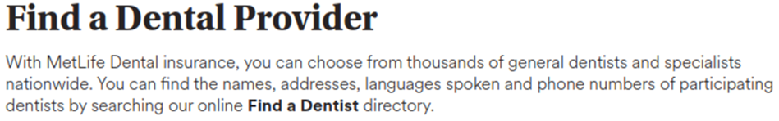

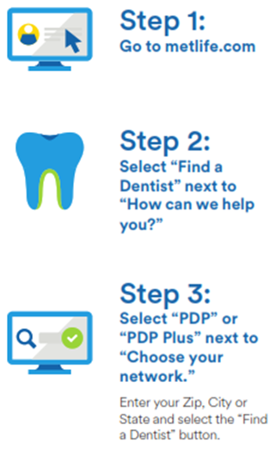

Dental – Network Considerations
Notes:
This slide shows network considerations to keep in mind as you choose your dental plan.

Slide 32

Vision
Notes:
Next, let’s review at vision benefits.

Slide 33
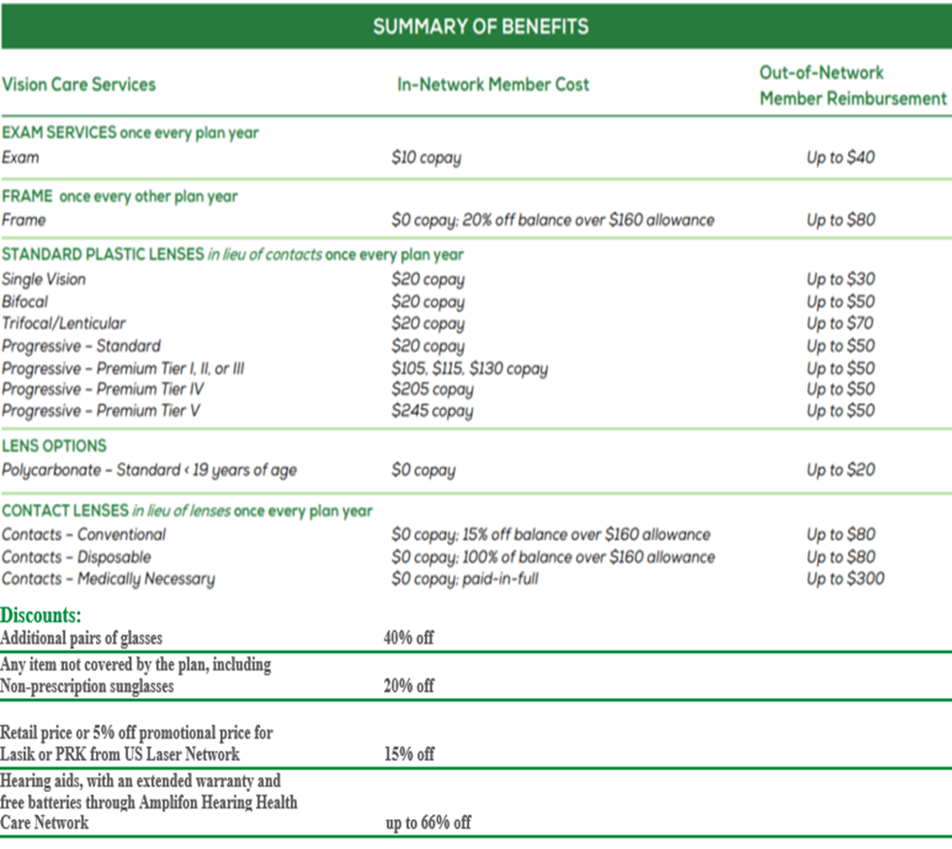

Vision – Benefit Highlights
Vision - EyeMed (per pay/24 pays per year)
Single | $2.53
EE + Spouse | $5.31
EE + Child(ren) | $6.08
Family | $7.29
Notes:
Effective January 1, 2026 vision will now be through EyeMed.
The plan features a $10 copay for an eye exam, available every 12 months.
A $20 copay covers lenses ever 12 months, though additional services may apply for lens enhancements such as anti-glare coatings, scratch resistant coating, and alternate materials.
Frames are available every 24 months with an allowance of $160 at most retailers. You also have a 20% savings on the amount over your allowance.
Contacts are available instead of glasses every 12 months with the same $160 allowance.
Additional Exclusive Member Benefits Include:
Discounts for additional pairs of glasses, including non-prescription sunglasses, Lasik and Hearing aids.

Slide 34

Life and disability benefits
Notes:
Let’s next look at additional lines of coverage offered through your employer. Life and Disability benefits will now be through Mutual of Omaha effective January 1st.

Slide 35
Basic Life/AD&D
Clermont County provides $25,000 Basic Life and $25,000 AD&D benefits to all eligible full-time employees at no cost to you*.
The Life insurance benefit will be paid to your designated beneficiary in the event of death while covered under the plan. The AD&D benefit will be paid in the event of a loss of life or limb by accident while covered under the plan.
*Does not apply to CCDD employees – see your personnel department for details.
Please be sure to review and update your beneficiary information as needed; does not have to be done during Open Enrollment.
Notes:
Clermont County continues to provide $25,000 Basic Life and $25,000 accidental death and dismemberment benefits to all eligible full-time employees at no cost to you. The Life insurance benefit will be paid to your designated beneficiary in the event of death while covered under the plan. The accidental death and dismemberment benefit will be paid in the event of a loss of life or limb by accident while covered under the plan.
*This benefit does not apply to CCDD employees – see your personnel department for details.
Friendly reminder this is a good time to review and upate your beneficiary information.

Slide 36
Voluntary Life Insurance
New Hire / New Benefit Eligible Employees | New Hires can elect up to up to $250,000; can apply for up to $500,000 maximum by completing an EOI* (Evidence of Insurability) Elect up to $50,000 for spouse without EOI Elect child life up to $20,000 without EOI Spouse and/or child(ren) coverage cannot be more than the employee’s own voluntary life coverage.
CHANGES PERMITTED DURING OPEN ENROLLMENT:
Employee | Existing employee coverage can be increased up to $250,000 without an EOI. Maximum coverage is $500,000.
Spouse | Can increase spouse coverage up to $50,000 without an EOI. Maximum coverage is $300,000 with approved EOI, but not more than the employees’ own coverage. Dependent coverage cannot be more than the employee’s coverage.
Child(ren) | Can elect up to $20,000 (increments of $5,000) Maximum is $20,000 (one policy covers all children in the family) Dependent coverage cannot be more than the employee’s coverage.
Evidence of Insurability (EOI) | You will be required to submit an EOI if requesting: More than $250,000 as a new hire or newly benefit eligible employee. More than $50, 000 spousal coverage.
ENROLLMENT NOTES: Enter the coverage amount in ESS – the system will calculate the per pay deduction based on age.
*EOI is the acronym for Evidence of Insurability (a medical information declaration).
Notes:
In addition to the employer paid Basic Life and accidental death and dismemberment coverage, you have the option to “buy-up” voluntary life insurance and accidental death and dismemberment coverage. Cost of coverage depends on the amount of coverage you elect and your current age. Election, however, could be subject to medical questions and evidence of insurability. Your contributions will depend on your age and the amount of coverage you elect. If you elect voluntary employee life insurance, you also have the option to purchase coverage for your spouse and/or dependent children.

Slide 37
Long Term Disability
Clermont County provides you with long-term income protection through Mutual of Omaha Financial in the event you become unable to work due to a non-work-related illness or injury until you have 5 years of OPERS service. The following highlights details regarding our long-term disability plan.
*Employees with 5 or more years of service may qualify for a similar benefit through the Ohio Public Employees Retirement System
 | Mutual of Omaha Long-Term Disability (LTD)
Elimination Period | 180 days
LTD Benefit | 60% up to a monthly maximum of $5,000
Definition of Disability | 3 years own occupation
Maximum Disability Period | Social Security normal retirement age.
Pre-Existing Condition Limitations | 12 months for conditions treated within the 12 months prior to effective date of coverage
Notes:
Clermont County provides you with long-term income protection through Mutual of Omaha in the event you become unable to work due to a non-work-related illness or injury until you have 5 years of OPERS service. The following highlights details regarding our long-term disability plan.
The Elimination Period is 180 days
The Long-Term Disability is 60% up to a monthly maximum of $5,000
Definition of Disability is 3 years own occupation
The Maximum Disability Period is to Social Security normal retirement age
Pre-Existing Condition Limitations is 12 months for conditions treated within the 12 months prior to effective date of coverage
Not that Employees with 5 or more years of service may qualify for a similar benefit through the Ohio Public Employees Retirement System

Slide 38

Supplemental plans
Notes:
Next, let’s review the enrollment process.

Slide 39
Supplemental Plans
Clermont County also offers a wide selection of supplemental plans. Supplemental plans are available for full-time and also part-time employees who are regularly scheduled to work 20 hours or more per week.
Allstate Cancer Coverage
Allstate Critical Illness
Allstate Accident Insurance
Allstate Universal Life Insurance
Trustmark Voluntary STD (Short-term Disability) Insurance
Trustmark Voluntary LTD (Long-term Disability) Insurance
For Additional Information and rates, call Star Robbins Company: 800-486-7721
Open Enrollment for these supplemental coverages will take place in June 2026
Notes:
Clermont County also offers a wide selection of supplemental plans. Supplemental plans are available for full-time and also part-time employees who are regularly scheduled to work 20 hours or more per week.
For additional Information and rates on:
Allstate Cancer Coverage
Allstate Critical Illness
Allstate Accident Insurance
Allstate Universal Life Insurance
Trustmark Voluntary (STD) Short Term Disability & (LTD) Long-Term Disability Insurance
call Star Robbins Company at 800-486-7721

Slide 40


Questions & Resources
Notes:
Finally, let’s review some resources.

Slide 41
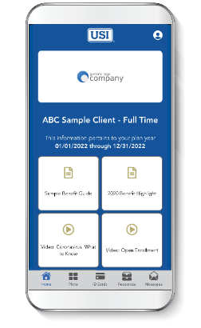
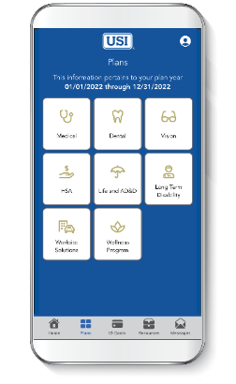
Benefits Mobile App
MyBenefits2GO provides on-the-go access to your benefit plan details, HR contact information and more!
MyBenefits2GO is a quick and simple way for you and your enrolled dependents to access benefit summaries and other important information about our group plans. Store photos of ID cards and easily locate carrier and HR contact information—all in one place. The app is free and available for iPhone and Android.
Download in the App Store or Google Play Store and enter code G28511 in the app to access your benefits.
Stay Organized
Store your benefit plan information and ID cards in one easy-to-find place.
Lighten Your Wallet
Save a photo of your ID card for each plan so you always have it when you need it.
Get In Touch
Find the contact information for carriers and HR all in one spot.
Notes:
The USI EB app provides a quick and simple way for you and your benefit plan participants to access benefit summaries and other important information about your group plans. The app also offers the ability to take photos of ID cards to store on the phone, as well as a way to easily locate carrier and HR contact information—all in one place—24/7 and on the go.
Download in the App Store or Google Play Store and enter code G28511 in the app to access your benefits.

Slide 42

Life is filled with change and uncertainty. The responsibilities and demands on our time can be overwhelming. It happens to all of us. Whenever you or your immediate family members need help dealing with life’s challenges, our Employee Assistance Program, administered by ComPysch is here to help.
You and your dependents have access to five (5) free face to face sessions or to other resources per year provided by Clermont County employees and their immediate family members through ComPsych. Services include:
To schedule a confidential appointment: Call: 877.327.4452 TTY: 800.697.0353
Your toll-free number gives you direct, 24/7 access to a GuidanceConsultantSM, who will answer your questions and, if needed, refer you to a counselor or other resources.
Online: guidanceresources.com
App: GuidanceNowSM
Web ID: EAPCEB
Log on today to connect directly with a GuidanceConsultant about your issue or to consult articles, podcasts, videos and other helpful tools
Anger Management | Conflict Resolution | Drug, Gambling, Alcohol Additions
Legal Guidance | Locating Dependent or Elder Care | Personal & Mental Health
Financial Resources | Grief Counseling | Work Related Issues
Retirement Planning | Hiring movers or home repair contractors | Work-Life Solutions
Notes:
Employee Assistance Program (EAP) is offered to all employees of Clermont County at no cost.
Clermont County employees, spouses/partners and dependents in the home are eligible for up to 5 confidential counseling sessions per issue with a licensed counselor.
EAP offers support for many aspects of life such as; Stress Management, Crisis Support, Relationships, Emotional Health, Grief & Loss, Addictions and Financial Counseling.
These sessions can be by telephone, video or in-person sessions and are completely confidential.
You can call to schedule an appointment or go online and access resources.

Slide 43
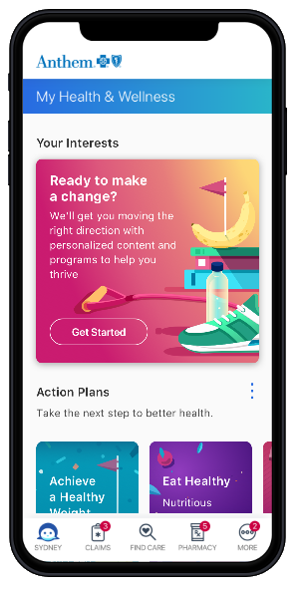
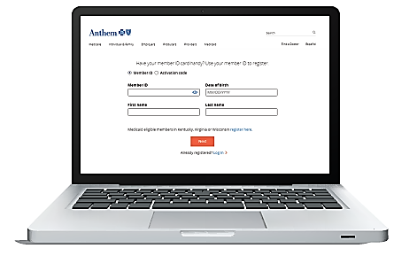
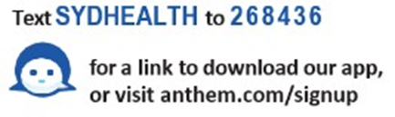


If If you haven’t done so already…Register Today!you haven’t done so already…Register Today!
Got to Anthem.com/register
Provide the information requested
Create a username and password
Set your email preferences
Follow the prompts to complete your registration
Download the free Sydney mobile app and Select Register
Confirm your identity
Create a username and password
Confirm your email preferences
Follow the prompts to complete your registration
43
Need help signing up? Call your member services number on the back of your Anthem ID card.
Notes:
It is not enough for a health plan to blindly connect data—those insights need to work harder. For true, lasting transformation in healthcare, it takes learning, listening, and gaining an unprecedented line of sight into the health journey of each individual member.
At Anthem, our ecosystem is built around this customer journey, with every piece connected by a single purpose: installing everyone with the confidence of care.
Anthem partners with local experts to overcome some of the toughest health challenges people are facing. We do it through unique combination of technology and empathy — allowing us to re-invent how we deliver health today and tomorrow.
Here are some of the ways we are working to move people, business, and healthcare forward.
Digital-first ecosystem
We believe the future of healthcare is a thriving, interconnected ecosystem fed by data and digital. Where technology makes the human experience more cohesive. In this kind of health ecosystem, all aspects of healthcare—doctors, health plans, wellness tools, everything—work together seamlessly to create more efficient and effective care, and a more connected experience for everyone. At Anthem, we are actively working to build the healthcare ecosystem of tomorrow, right now.
Human-focused data and artificial intelligence
Data is meaningless unless you recognize that there is a real person behind each datapoint. With Anthem, you have a health plan that’s harnessing the power of artificial intelligence (AI) and data science to improve every moment of health—informing the way we collaborate with providers, customize networks, unify the member experience, and reduce the total cost of care.
Health in real time
As we touched on earlier, every moment is an opportunity to learn and impact a person’s health. At Anthem, those opportunities do not go to waste. Using real-time population health analytics, we are meeting members where they are, when they need us most, to improve health—and keep costs down—proactively.
Tools that power life
Finally, we have smarter, more human-centered tools that can impact members’ real lives, right now. It is all anchored by digital experiences, like apps, that combine the power of artificial intelligence with the emotional intelligence of a real person. A person who is always there to help.

Slide 44

Benefit Resource Center
Contact the USI Benefit Resource Center (BRC) for free, confidential help!
  Benefit coverage levels
  Carrier information
  Claims assistance
  Billing issues
855-874-0829
BRCMidwest@usi.com
Monday through Friday 8:00am to 5:00pm Eastern & Central Standard Time
Notes:
USI’s Benefit Resource Center is a group of USI Employees that are ready and standing by to take your benefit questions and help resolve any issues you may have. Whether you’d like help deciding which plan may be best for you, or simply need a new ID card, the BRC is there to help. The BRC is available by phone at 855-874-0829 or by email at BRCMidwest@usi.com

Slide 45
Website Links
Anthem: https://www.anthem.com/ and Carelon Rx: https://www.carelonrx.com/
Medical insurance provider and prescription coverage.
Bloom: https://meet.swordhealth.com/bloom/cebco
1 in 3 women suffer from pelvic health disorders including bladder issues, bowel dysfunction, and pelvic pain. Sword Health developed Bloom to give you relief with an easy-to-use, at-home pelvic therapy solution.
Carelon Rx Cost Relief Program: The Cost Relief program offers you select specialty medicines at no cost to you. That means a $0 copay when you fill the prescription with the exclusive specialty pharmacy in your network. Please call 877-638-4008 Monday through Friday from 8 a.m. to 8 p.m. ET
ComPsych Guidance Resources is our Employee Assistance Program (EAP) : www.guidanceresources.com
EAP program provides 5 free sessions per incident for finding child or elderly care/ movers/ home repair/ pet care, free legal consultation: divorce/ adoption/ wills/ trusts, retirement planning/ insurance/ budgeting/ bankruptcy and an online library with articles/ podcasts/ videos/ on-demand training.
Lark: https://www.lark.com/anthem
The Lark Diabetes Prevention Program is an all-digital app that can help you lose weight and lower your risk of developing Type 2 Diabetes. Available to dependents 18+ years of age.
LiveHealth Online: https://livehealthonline.com/
Online Medical lets you visit a doctor 24/7.
SmartShopper: https://smartshopper.com/
Earn a reward check every time you and your family choose an eligible lower-cost, high-value doctor or facility for a variety of health services.
Sword: https://meet.swordhealth.com/thrive/cebco
The Sword digital physical therapy programs combine guidance from dedicated physical therapists with easy-to-use technology that result in real, meaningful results. Available to dependents 13+ years of age.
Sydney Health: https://www.sydneyhealth.com/
Wellness Plan and so much more!
Clermont County Employee Benefit Website: www.hr.clermontcountyohio.gov

Slide 46
Thank you!!
Thank you for your participation in this year’s open enrollment presentation.
All election changes are due by:
Monday, November 3rd
Notes:
Thank you for your participation in this year’s open enrollment presentation. Make sure to complete your election changes by the end of the enrollment period.

