Slide 1
After the Holidays; Managing Holiday Debt
Presented by ComPsych® Corporation

Slide 2
Holiday Season is the Spending Season
According to LendingTree’s 2023 Holiday survey
34% of Americans went into debt for holiday shopping (down from 35% in 2022)
65% who took on debt did not plan to take on debt (up from 63% in 2022)
On average, took on $1,028 worth of holiday debt (34% decrease from 2022)
Credit cards were the most common way to finance the holidays (67%)
33% have interest rates of at least 20%, 6% have rates of at least 30%

Slide 3
Objectives
Pay off debt from last year
Creating and implementing a budget.
Steps to get out of debt.
Tips to get out of debt quicker.
Debt Repayment Strategies
Stopping the cycle of debt
Holiday budget
Do’s and Don'ts of the Holiday Season
Additional tips.

Slide 4
Assess the Situation
List all your debt
Credit Cards
Store, Gas, Retail
Personal Loans
Payday, Bank, Family
Include Information
Total amount owed
Minimum payments
Due dates
Interest rates
What do you want to accomplish?
Set Goals
Set Time Frames

Slide 5
Create a Plan
What does a budget do?
Allows you to get organized.
Tracks Income and Expenses.
Shows you a realistic picture of where you stand.
Shows where you can make changes.
Shows how much you can afford to pay off your debt.
Why do Budgets fail?
Not having goals.
Not staying on top of spending.
Not recording everything.
Frustration.
Not being on the same page.
The more information you have, the better decisions you can make.
In order to pay off your holiday debt you will need to develop a Budget.

Slide 6
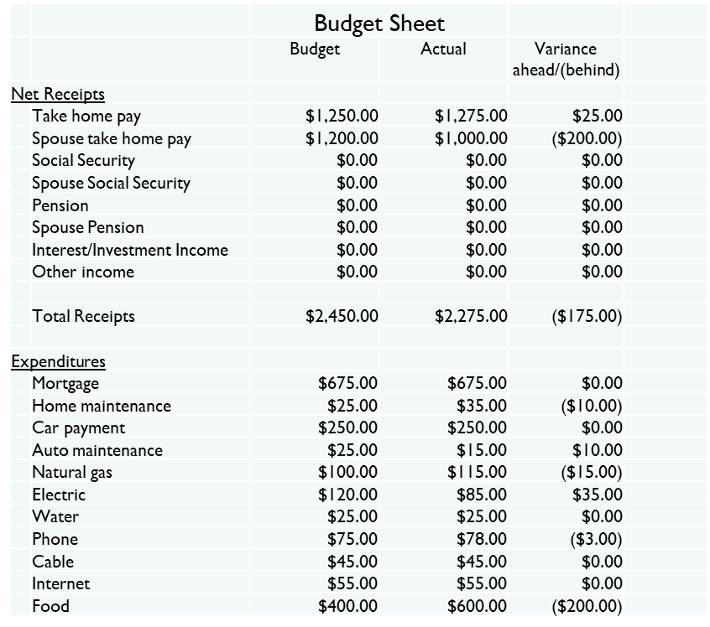
Sample Budget Sheet

Slide 7
Tips to get out of debt fast
To increase the speed at which you can pay off the debt:
Reduce and eliminate expenses
Determine NEEDS vs WANTS
Cut out non-essentials
Cut/reduce monthly bills
Stop using credit cards
Increase income
Get a second job
Sell some stuff
Use tax refunds and bonuses wisely
The more money you can free up each month, the faster you can get out of debt.

Slide 8
Payment Strategies: Avalanche vs Snowball
Snowball
Focus is on balances
Goes for quick wins
Dave Ramsey
How it works
Pay off the lowest balance first
Then second lowest and so on
Using the same amount each month
Example
Card 1 $2,000 balance
Card 2 $500 balance
Card 3 $1,500 balance
Pay minimums on cards 1, 2 & 3 and everything extra on card 2.
Avalanche
Focus is on interest rates
Fastest overall way at least cost
Takes more discipline
How it works
Pay off highest interest rate first
Then second highest and so on
Using the same amount each month
Example
Card 1 $,2000 balance, rate 20%
Card 2 $500 balance, rate 22%
Card 2 $1,500 balance, rate 26%
Pay minimums on card 1, 2 & 3 and everything extra on card 3

Slide 9
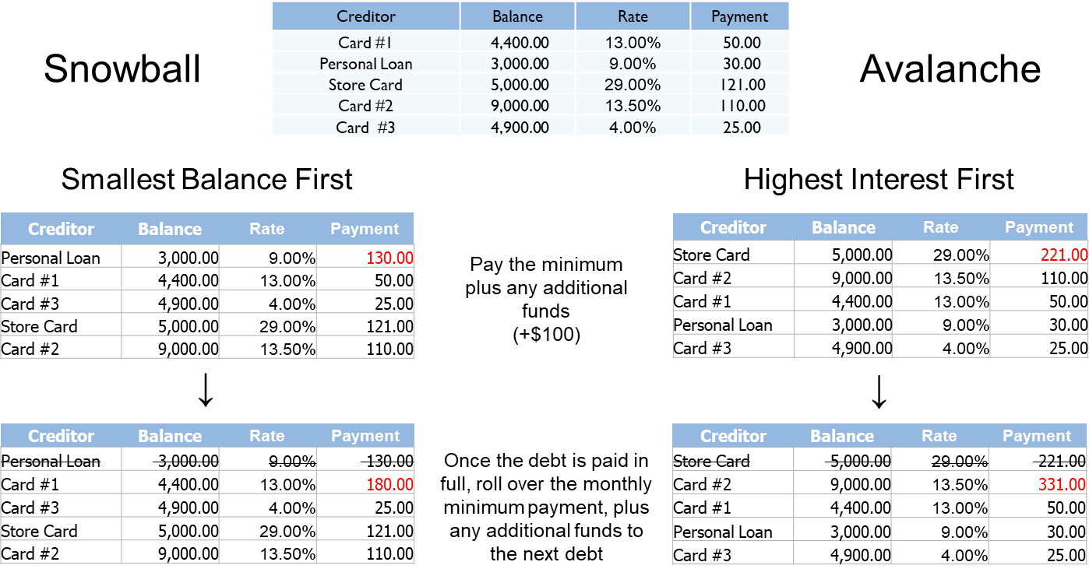
Example: Snowball vs Avalanche

Slide 10
Stopping the cycle of Holiday debt
Creating a Holiday Budget
Step 1: Review last year’s expenses
Note where the money went
Step 2: Create a budget for the Holidays
Gifts, food, gas, decorations and travel
How much do you need?
Step 3: Create a plan
How will you achieve this?
What will you give up?
How much will you save per month to get to your goal?
Step 4: Execute
Open a separate savings account

Slide 11
Do’s and Don’ts
Do’s
Pay off last years debt first
Set limits – budget and spending plan
Avoid impulse buys – shop with a list
Shop early (tickets, post holiday sales)
Give only what you can afford
Keep your LT and ST goals in mind
Talk to your family about your financial situation (everyone on the same page)
Meaningful over pricey
Supplement income
Don’ts
Buy big ticket items without a plan to pay them off
Use credit cards
Go into further debt
Dip into your emergency savings
Dip into your retirement
Buy what you cannot afford
Spend to save (Black Friday)
Go to places centered around spending money

Slide 12
Additional Ideas
Always pay on time (autopay)
Consolidate your debt
0% credit cards
Personal loans
Don’t dip into retirement
Don’t dip into home equity
Credit Counseling
Debt Management Plans
Seek advice/options – ASK FOR HELP
www.nfcc.org

Slide 13



Thank You for Attending
Your single source for confidential support, expert information and valuable resources, when you need it the most.
Available 24 hours a day, 7 days a week
Online: guidanceresources.com
Mobile App:GuidanceNow
Follow us!

