Slide 1
Deskercise! Taking Care of Your Body During the Workday
Presented by ComPsych® Corporation

Slide 2
Agenda
Learn why sedentary lifestyles are hazardous for your health
Identify exercises to incorporate into your workday
Understand the relationship between physical and mental stress
Practice mind-body connection through stress management exercises

Slide 3

Hazards of Sitting
Decreased Metabolism
Greater Risk for Disease
Poor Posture

Slide 4

Why Should I Move More?
Prevent or Delay:
Heart Attacks
Diabetes
Depression

Slide 5
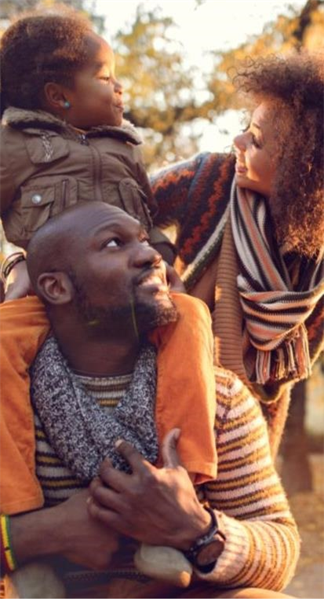
Functional Movement
A natural way of carrying ourselves through our daily lives with more ease and freedom
Twist
Hinge
Push/ Pull
Sit/ Stand
Walk

Slide 6
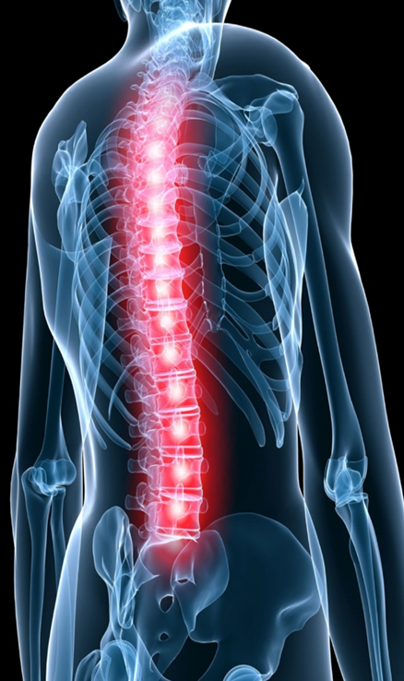
Mobility
Our spine is capable of moving in 7 different ways:
Flex (forward)
Extend (backward)
Rotate (left)
Rotate (right)
Lateral lean (left)
Lateral lean (right)
Axial extension (lengthen)

Slide 7
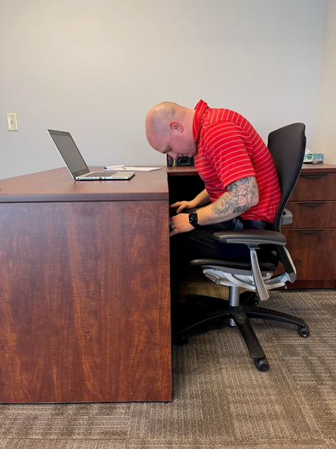
Mobility - Flex
Flexion- decreasing the angle between parts or bending forward
Drop your chin towards your chest
Curve your spine forward to make a C shape with your spine

Slide 8
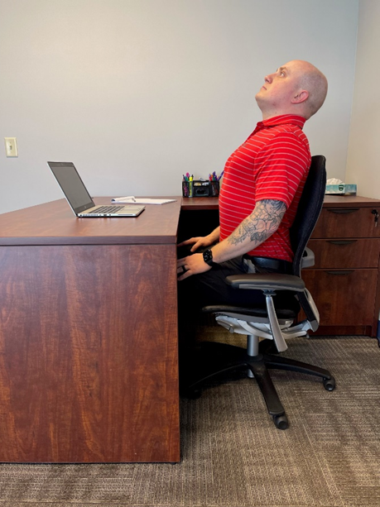
Mobility - Extend
Extension- increasing the angle between parts or leaning backward
Lift your gaze toward the ceiling
Imagine your spine arching up and over like the shape of a candy cane

Slide 9
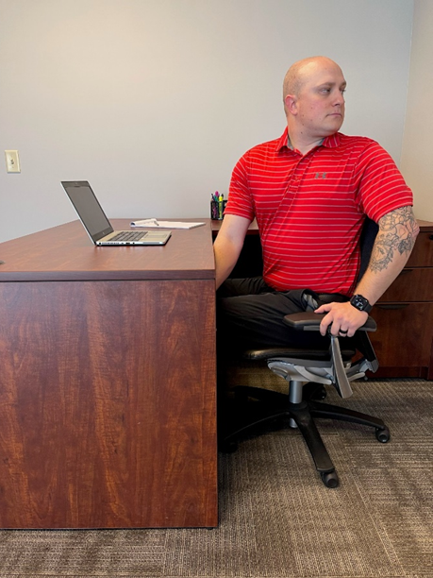
Mobility - Rotate
Rotate (left and right)- spiraling from center axis
Gently shift your gaze up and over your left shoulder
Rotate your upper body to the left
Hold for one breath cycle
Come back through center
Repeat on opposite side

Slide 10
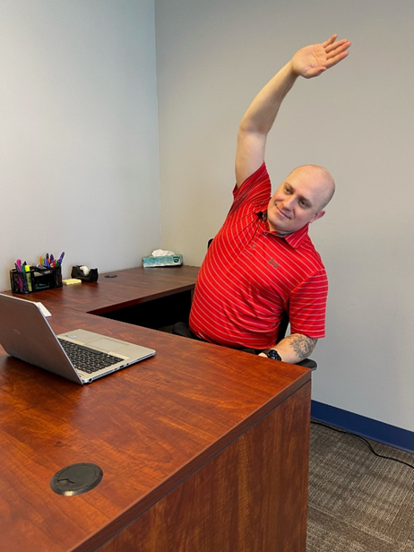
Mobility – Lateral Lean
Lateral lean (left and right)- decreasing the angle on the side line of the body
Slowly drop your left ear towards your left shoulder
Allow your shoulder to fall towards the floor, deepening the bend
Reach your right arm up and over to the left side, if flexibility allows
Return to center upright with a tall spine
Repeat on opposite side

Slide 11
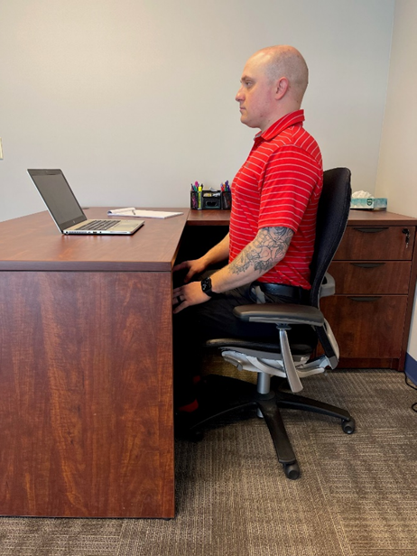
Mobility – Axial Extension
Axial extension- lengthening or growing
Imagine there is a string attached to the top of your head like a puppet
As you inhale feel the string pull up towards the ceiling and your spine grow taller

Slide 12

Push/Pull Movement: Upper Body
Shoulder Shrug
Goal Post
Overhead Press
Chest Press

Slide 13
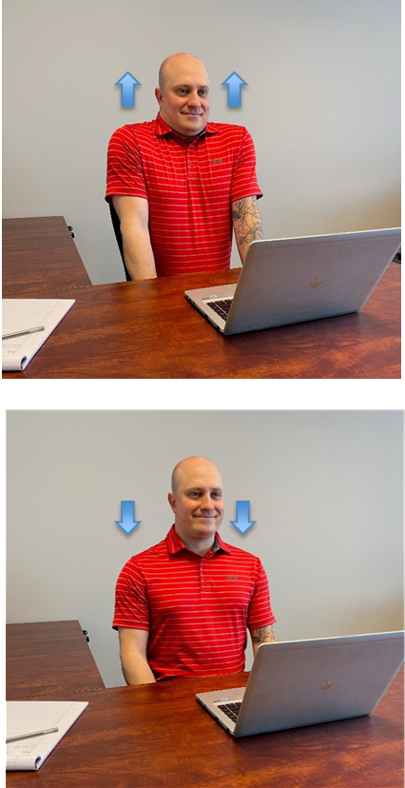
Upper Body – Shoulder Shrug
Raise your shoulders up to your ears
Then press them wide and down your back
Repeat

Slide 14
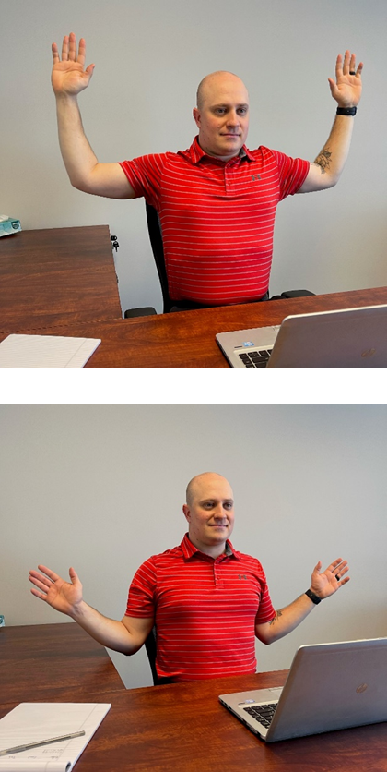
Upper Body – Goal Post
Lift your elbows up and out to the sides making a goal post shape with your arms
Then pull your elbows down to your side, like you are popping a balloon under your armpit
Repeat

Slide 15
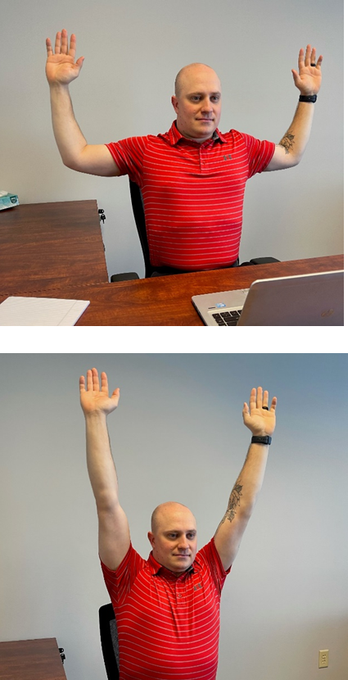
Upper Body – Overhead Press
Lift your elbows up and out to the sides making a goal post shape
Then press your hands up, keeping your arms in line with your ears
Return by pulling your elbows down to your side body imagining you are popping a balloon under your armpit
Repeat

Slide 16
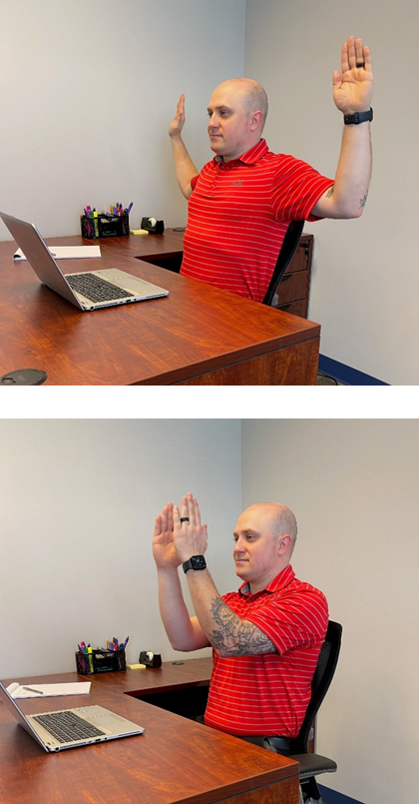
Upper Body – Chest Press
Lift your elbows up and out to the sides making a goal post shape
Press your arms together towards your midline like you are closing a book
Then, open them back up to the side in your goal post
Repeat

Slide 17
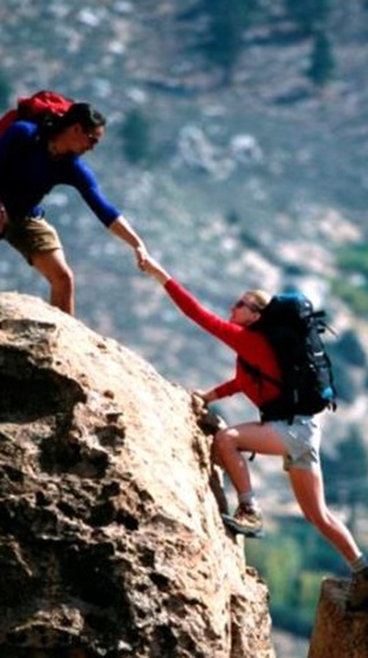
Push/Pull Movement: Lower Body
March (seated or standing)
Ankle Pump or Calf Raise
Glute Contraction or Chair Squats

Slide 18
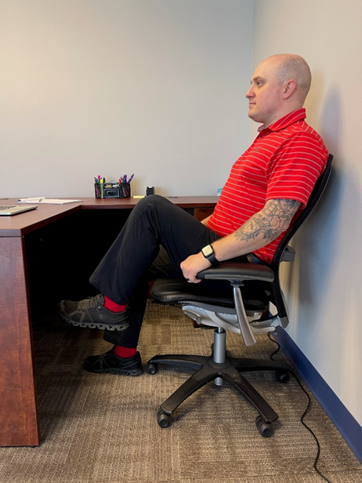
Lower Body - March
Seated Option
Come to an upright seated position with your legs uncrossed, and your feet flat on the floor
Pull your right knee up towards your chest as flexibility allows
Then lower it back down
Continue to alternate sides several times

Slide 19
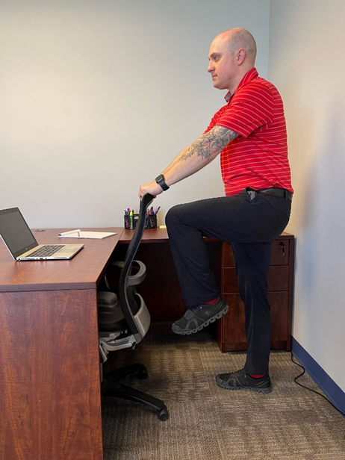
Lower Body - March
Standing Option
Come to a standing position with your feet directly below your hips
Hold on to a stable chair or table top for balance
Pull your right knee up towards your chest as flexibility allows
Lower it back down
Continue to alternate sides several times

Slide 20
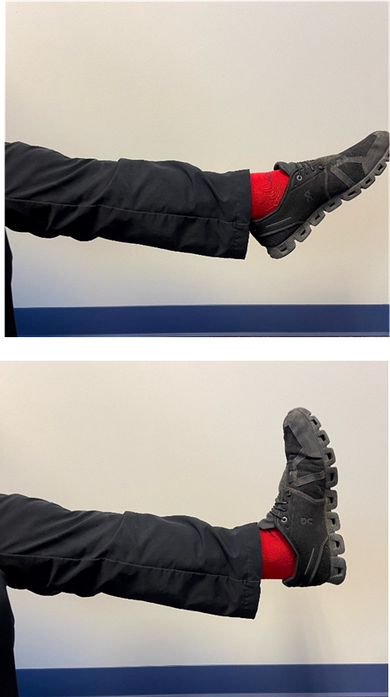
Lower Body – Ankle Pump
Seated Option
Extend your right leg so that your foot is hovered off of the floor
Flex and extend your ankle like you are pressing and releasing the gas peddle in your car
Repeat
Repeat on left leg

Slide 21
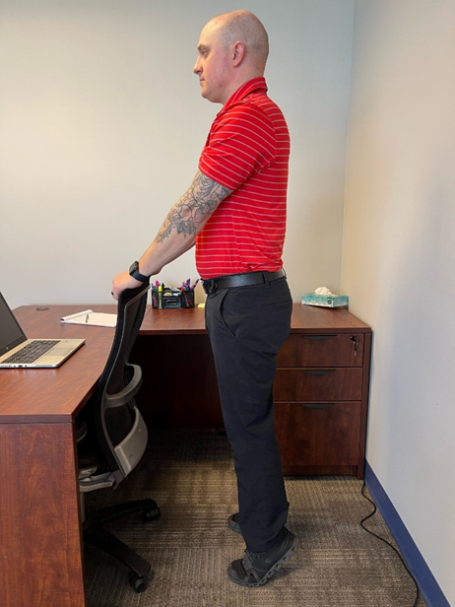
Lower Body – Calf Raise
Standing Option
Come to a standing position with your feet directly below your hips
Shift your weight into the balls of your feet
Lift your heels off of the ground
Carefully lower your heels
Repeat

Slide 22
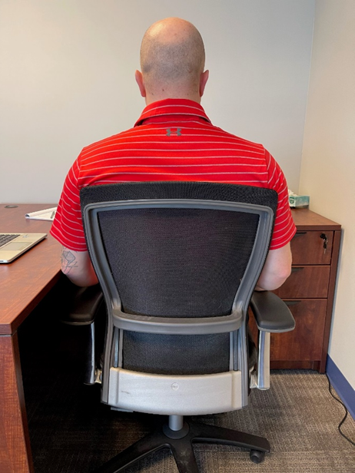
Lower Body – Glute Contraction
Seated Option
Come to an upright seated position with your legs uncrossed, and your feet flat on the floor
Slowly squeeze your buttocks muscles together
Release
Repeat

Slide 23
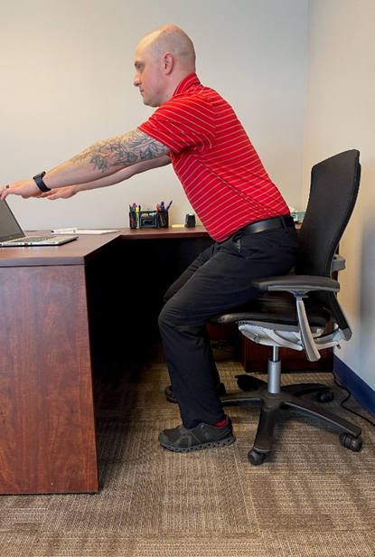
Lower Body – Chair Squat
Standing Option
Come to an upright seated position with your legs uncrossed, and your feet flat on the floor
Press your heels firmly into the floor to drive yourself up to a standing position
Slowly hinge your spine forward and reach your glutes back to return to a seated position
Repeat

Slide 24
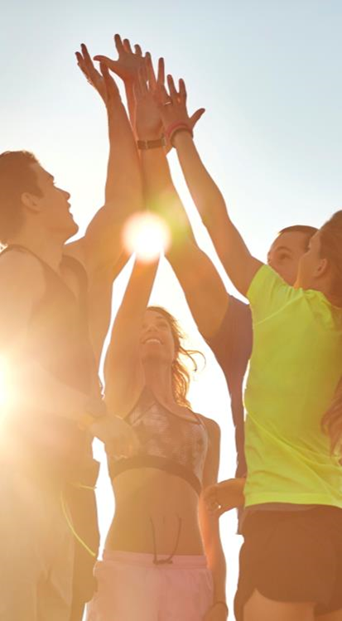
Start Moving Today
Track amount of movement during 1 day
Set reminders to move
Evaluate break times

Slide 25

Warning Signs
Feeling anxious, irritable or depressed
Loss of interest in work
Problems sleeping
Fatigue
Muscle tension or headaches
Stomach problems
Social withdrawal
Trouble concentrating

Slide 26
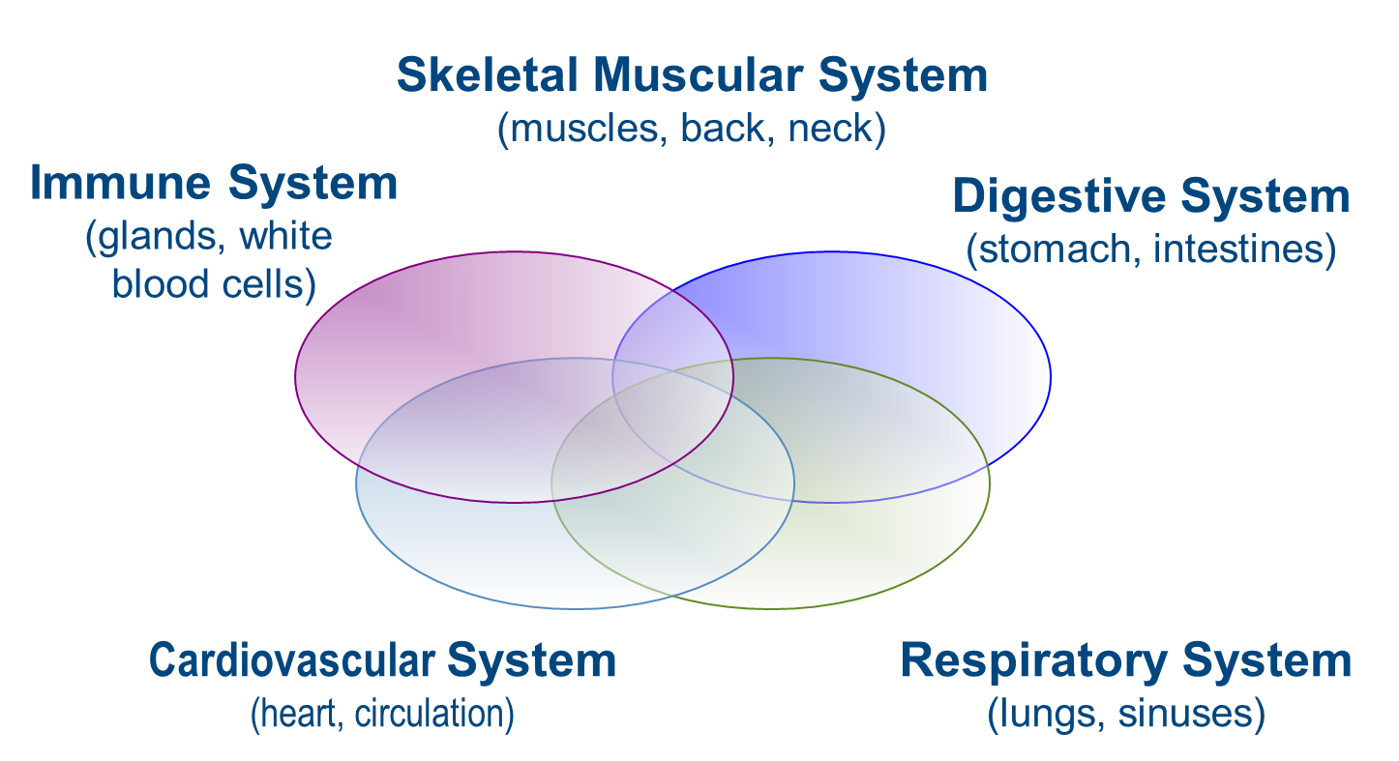
The Effects of Stress on Our Bodies

Slide 27

Stress At Work
Take responsibility
Avoid pitfalls
Learn better communication skills

Slide 28

Stress Management Exercises
5 Finger Breathing
Inhale, trace up your finger, exhale, trace back down
Progressive Muscle Relaxation
Tense a muscle group and HOLD for 5-10 seconds, release for 20 seconds

Slide 29
Summary
In this session we:
Learned why sedentary lifestyles are hazardous for your health
Identified exercises to incorporate into your workday
Discussed the relationship between physical and mental stress
Practiced mind-body connection through stress management exercises

Slide 30



Thank You for Attending
Your single source for confidential support, expert information and valuable resources, when you need it the most.
Available 24 hours a day, 7 days a week
Online: guidanceresources.com
Mobile App:GuidanceNow
Follow us!

