Slide 1

Healthy
Food Choices on the Go

Slide 2
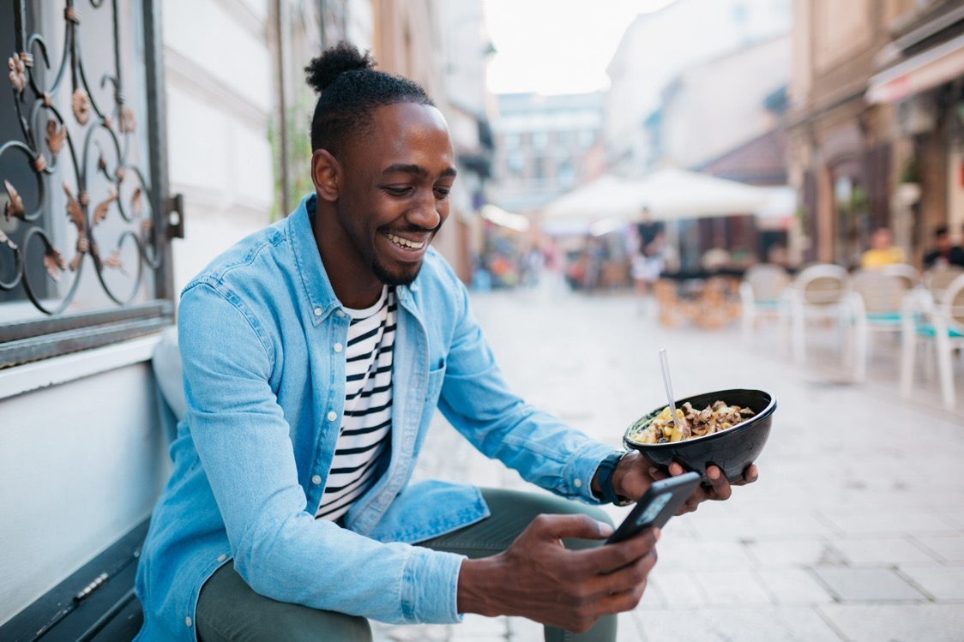
Understand the importance
of good nutrition
Learn healthy meal
options on the go
Improve menu reading skills
Identify healthy snacks
to keep on hand
Discuss best practices
from your experience

Slide 3





Benefits of Good Nutrition
Weight Management
Increased Energy
Better Concentration
Reduced Hunger
Disease Prevention

Slide 4

Determine:
Breakfast Considerations
Time
Location
Preferences
Grab-and-Go Breakfast Options
Fruit & protein smoothie
Peanut butter and banana wrap
Overnight oats with milk
Yogurt parfait
Hard boiled eggs with whole wheat toast

Slide 5
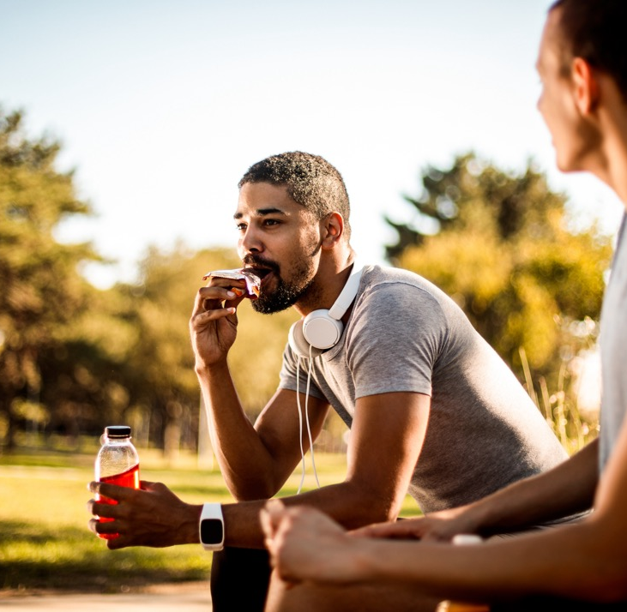
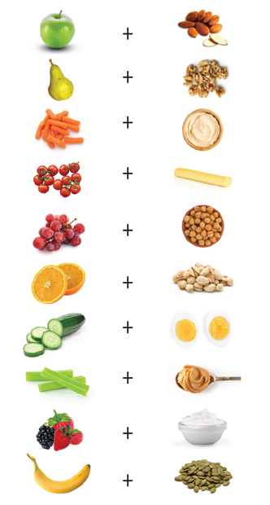
Mix and Match
No Preparation Needed
Fruit – apple, banana,
berries, orange
Low-fat yogurt/Greek yogurt
Whole grain cereal or granola
Nuts – almonds,
walnuts, cashews
Cottage cheese
Pre-made hard boiled egg
Cereal bars/granola bars
Pre-made protein shakes

Slide 6
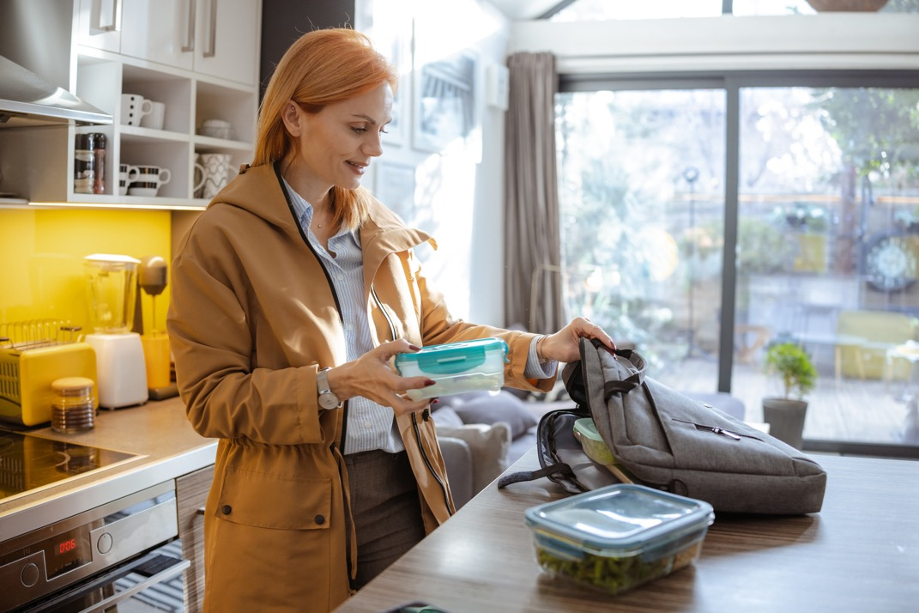
Determine:
Lunch Considerations
Location
Resources available
Company
Packing Equipment
Durable bag
Containers with lids
Eating utensils
Napkins

Slide 7
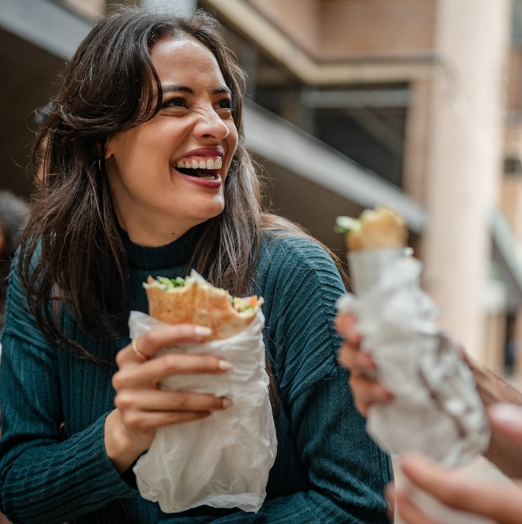
Quick and Easy Lunch Options
Make it a Meal
Leftovers from previous dinner
Build a salad
“Tapas” style
Frozen options
Sandwich on whole grain bread,
lunch meat, veggies and avocado
Veggie & protein bowl with brown rice, chickpeas (or grilled chicken), mixed greens, tomatoes, cucumber, and avocado
Lettuce wraps with tuna salad and piece of fruit
Greek yogurt with fruit and granola

Slide 8

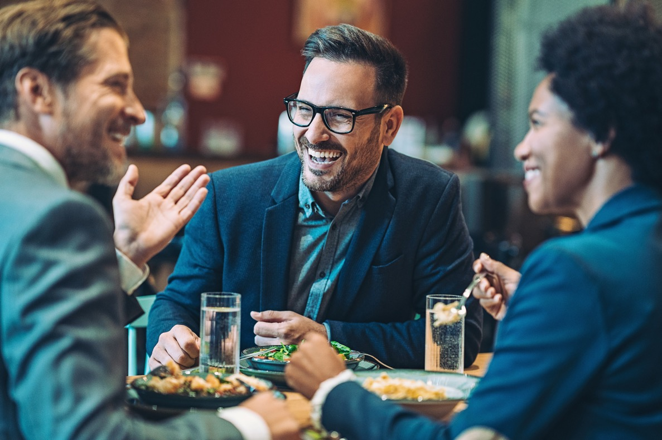
Healthy Tips for Dining Out
Plan ahead
Eat smaller meals earlier
Skip or portion
out bread and chips
Customize
your order

Slide 9

Navigate the Menu
Choose
Grilled, baked, broiled,
poached or steamed
Avoid or limit:
Battered-fried, creamed, crispy, deep-fried or cured
Fill up on fruits and vegetables
Choose lean proteins
Ask for dressing and sauces on the side

Slide 10
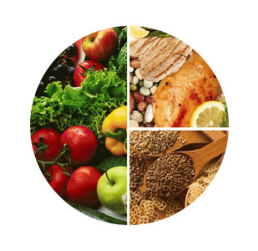
Portion Control While Dining Out
25%
Protein-rich foods
How hungry are you?
Check in with your hunger level before, during and after eating
Share dishes or desserts
Order á la carte
Use the healthy plate method
Ask for a to-go box
50%
Fruits & vegetables
25%
Whole-grain & fiber-rich carbohydrates

Slide 11

Beverages on the Go
Avoid Sugary Drinks
Water
Rehydrates
Calorie-free
Chemical-free
Carry a water bottle
Cofeee and Tea
Avoid sweeteners and creamers
Packed with antioxidants

Slide 12

Snacking on the Go
Where do you keep snacks now?
What snacks do you buy?
Convenience and accessibility

Slide 13


Healthy Snack Ideas
Shelf Stable Options
Nuts or trail mix
Granola bar
Piece of fruit
Pre-portioned snacks
Balanced Combinations
Greek yogurt with fruit
or fiber rich cereal
Avocado on whole grain toast
Cottage cheese with pineapple
String cheese with apple
Nut butter with
whole-grain crackers
Hard boiled egg with pear

Slide 14

Travel Snacks
Food
Hydration
Prevent boredom snacking

Slide 15
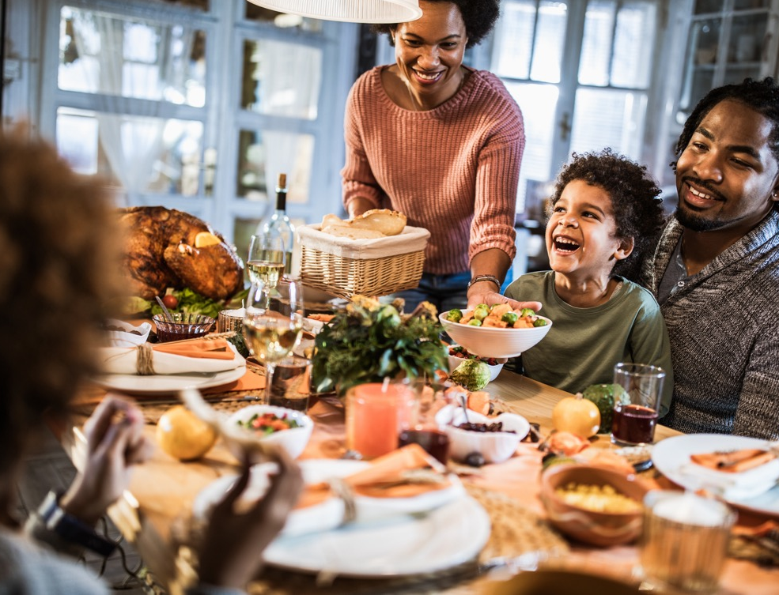
Holiday Eating Tips
Set realistic goals
Focus on eating when time
to eat
Prioritize treats
Return back to normal eating habits as soon as possible
Dealing with critics

Slide 16


Eating Healthy While on Vacation
Research and plan before your trip
Consider the following:
What is your mode of transportation?
How long will you be gone?
Where will you be staying?
Eat regular meals and snacks

Slide 17
Wrap-Up
Area of Opportunity | Current Food/ Beverage Choice(s) | Improvement
Example: Mid-morning hunger | Snack from break room Vending machine Ignore | Bring pre-portioned trail mix to keep in desk drawer Drink a large glass of water and reevaluate hunger

Slide 18


