Slide 1
Learning To Relax
Presented by ComPsych® Corporation

Slide 2
Objectives
Reduce stress by learning to relax the body through:
Developing body awareness
Progressive muscle relaxation
Breathing
Visualization

Slide 3

Outside vs. Inside Awareness
Focus your attention on the outside world by finishing this sentence:
“I’m aware of ___________________.”
Next shift your attention to what is happening in your body:
“I’m aware of ___________________.”
Now go back and forth a few times between observations of the outside world and experiences in your body

Slide 4

Body Scanning Awareness
Close your eyes and ask yourself, “Where am I tense?”
Begin with your hands.
  Can you feel your hands? How do they feel? Are they warm, cold? Are they carrying tension?
Move on to your wrists and then forearms, elbows, upper arms.
  Can you can feel or become aware of those separate body parts and to what extent are you holding tension there?
Move on to other body parts
  Our shoulders, neck, face and head.
  Try to isolate small parts: forehead, eyes, lips, jaw, and tongue.

Slide 5

Progressive Muscle Relaxation
Progressive muscle relaxation involves tensing each muscle group from 5 to 7 seconds and then relaxing it for 20 to 30 seconds and then repeating it at least once.
Hands, forearms and biceps
Head, face, throat and shoulders
Chest, stomach and lower back
Thighs, calves and feet

Slide 6

Tensing and Relaxing Suggestions
“Let go of the tension.”
“Feel the looseness of your body.”
“Allow the relaxation to spread.”
“Relax and smooth out the muscles.”
“Feel the warmth and heaviness of the muscle as it relaxes.”
“Allow the tension to dissolve away.”
“Let go more and more.”

Slide 7

Breathing
Place your hand over your abdomen.
Take a deep breath allowing your abdomen to expand, pushing your hand out.
Imagine a balloon in your stomach expanding upon inhalation and contracting on exhalation.
Now yawn and exhale with an audible sigh.

Slide 8
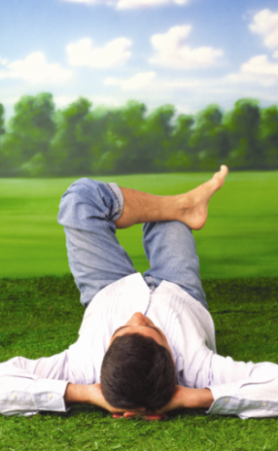
Visualization: Your Happy Place
Imagine you are in a place that you love. It can be a place you have been before, or a perfect place you make up. Wherever it is, you feel totally safe here.
This is your private sanctuary where you can come anytime you want to or need to.

Slide 9

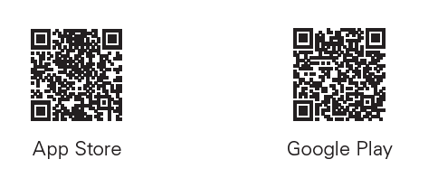

Thank You for Attending
Your single source for confidential support, expert information and valuable resources, when you need it the most.
Available 24 hours a day, 7 days a week
Online: guidanceresources.com
Mobile App:GuidanceNow
Follow us!

